Slide 2
Objectives
Knowledge:
Review the steps to design a function and a world program.
Skills:
Follow steps to design functions in the context of designing a world program.

Slide 3
Given the function signature and purpose statement, write 2 examples and their evaluations. The second example should use an expression that evaluates to the same result.
; add-two : Number-> Number ; adds 2 to a given number | ; string-delete : String Number -> String ; removes the 1String at the given index
Example 1 | Example 1
Example 2 | Example 2

Slide 4
Develop a function called profit that consumes the costs and revenue of a business and returns the companies profits. Profit is (revenue - costs).
Data: What data will represent the information in the problem?

Slide 5
Develop a function called profit that consumes the costs and revenue of a business and returns the companies profits. Profit is (revenue - costs).
Signature: Write the function signature as a well formatted comment in Racket.

Slide 6
Develop a function called profit that consumes the costs and revenue of a business and returns the companies profits. Profit is (revenue - costs).
Purpose Statement: Describe what the function will compute.

Slide 7
Develop a function called profit that consumes the costs and revenue of a business and returns the companies profits. Profit is (revenue - costs).
Stub or Template: Write the partially completed function definition.

Slide 8
Develop a function called profit that consumes the costs and revenue of a business and returns the companies profits. Profit is (revenue - costs).
Examples: Write at least 2 examples of the function being used and their evaluations. The second example should use an expression that will evaluate the result.

Slide 9
Develop a function called profit that consumes the costs and revenue of a business and returns the companies profits. Profit is (revenue - costs).
Definition: Write the complete definition of the function by abstracting your examples with formal parameters.

Slide 10
What are the steps to designing a function?

Slide 11
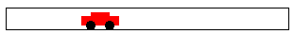
Define world constants

Slide 12
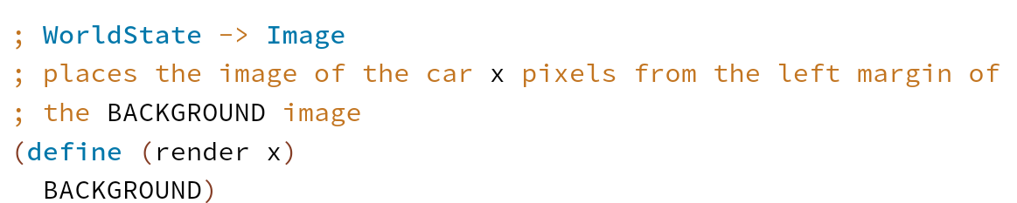
Render the world state as image

Slide 13
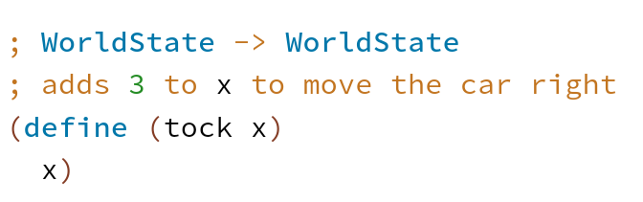
Update the world state to the next state

Slide 14
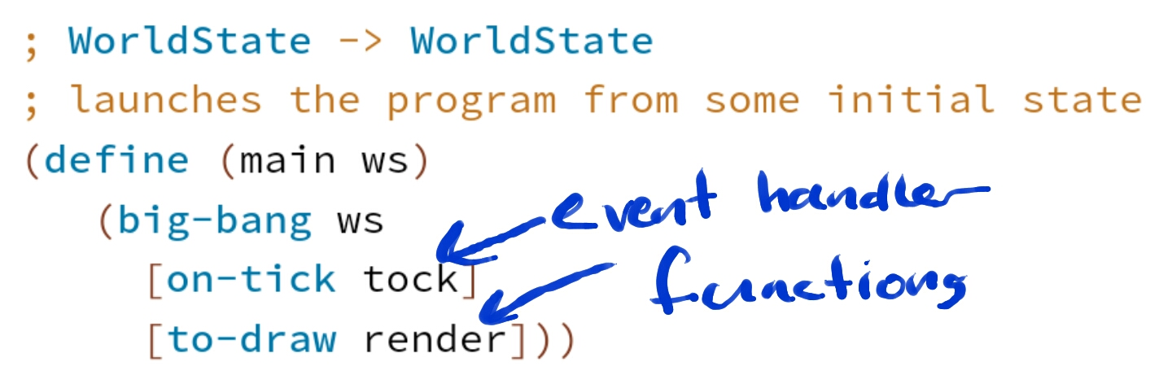
The main function launches the program

